Slide 1
CSE 165/ENGR 140 Intro to Object Orient Program
Lecture 1 - Introduction to Objects

Slide 2
CSE 165/ENGR 140: Fall 2021
Lecturer
Pengfei Su, psu9@ucmerced.edu
Office Hours: Th 4:00 - 6:00PM (or by appointment)
Zoom call: https://ucmerced.zoom.us/j/87406905790
TAs
Yuanzhou Yang, yyang127@ucmerced.edu
Office hours: F 9:00 - 11:00 AM (or by appointment)
In-person: SE2 lobby
Zoom call: https://ucmerced.zoom.us/j/87985022561
Mujahid Al Rafi, mrafi@ucmerced.edu
Office hours: F 5:00 – 6:00 PM (or by appointment)
In-person: SE2 lobby
Zoom call: https://ucmerced.zoom.us/j/86714952742

Slide 3
Course Overview
CatCourses
Check regularly for updates
2 lectures per week
1 lab per week or every 2 weeks (based on the workload)
The first lab on Friday, Sep 9
Mid-term exam: Wednesday, Oct 19 (tentative)
Final exam: Saturday, Dec 10

Slide 4
Course Objectives
Learn C and C++
Develop good programming habits
Understand the concept of object-oriented programming (OOP)
Labs
Giving each other help in finding bugs and in understanding the assignment is perfectly acceptable
You may allow other students to see small portions of your code on-screen as an example, but you may not allow them to copy directly (or give them copies of your code)
We will be using C++, specifically the GNU compiler tool-chain (g++ and gdb)

Slide 5
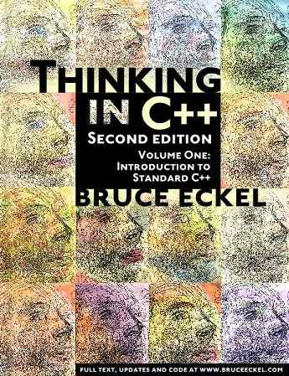
Course Materials
Textbook:
Bruce Eckel - Thinking in C++: Introduction to Standard C++, 2nd Edition, Volume 1-2
https://www.micc.unifi.it/bertini/download/programmazione/TICPP-2nd-ed-Vol-one-printed.pdf
https://www.micc.unifi.it/bertini/download/programmazione/TICPP-2nd-ed-Vol-two-printed.pdf
Slides
Posted after the lecture on CatCourses
Online resources
https://www.cplusplus.com/doc/tutorial
https://www.w3schools.com/cpp
https://www.tutorialspoint.com/cplusplus

Slide 6
Hints for success
Attend lectures
Read the textbook
Do & understand the labs YOURSELF
Ask questions

Slide 7
Grading
Mid-term: 25%
Final: 35%
Lab: 20%
Project: 20%

Slide 8
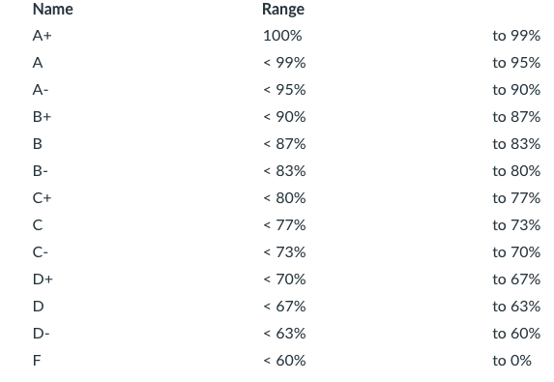
Grading scheme

Slide 9


About me
Originally from China
Ph.D. at William & Mary
Research interests: programming languages, performance analysis, parallel computing

Slide 10
History Lesson
C developed by Dennis Ritchie at AT&T Bell Labs in the 1970s
Used to maintain UNIX systems
Many commercial applications were written in C
C++ developed by Bjarne Stroustrup at AT&T Bell Labs in the 1980s.
Overcame several shortcomings of C
Incorporated object-oriented programming
C remains a subset of C++

Slide 11
History Lesson
Where did C++ come from?
Derived from the C language
C was derived from the B language
B was derived from the BCPL (Basic Combined Programming Language)
Why the ‘++’?
++ is the post-increment operator
Therefore, C++ is C, ++

Slide 12
Object oriented programming (OOP)
Everything is viewed as an object
A program is a bunch of objects telling each other what to do by sending message
Each object has its own memory made up of other objects
Every object has a type

Slide 13
Object oriented software goals
Robustness
How well can it handle errors?
Adaptability
How portable is it on different hardware architectures and operating systems?
Reusability
How much code can be reused in other applications?

Slide 14
Object oriented concepts
Encapsulation
The ability to package data with functions allows you to create a new data type
Example: members are encapsulated in a C++ class/struct
Implementation hiding
Access control
To prevent important data from being corrupted
Interface
Establishes what requests you can make for a particular object
An abstraction of an object
Tells what an object does without telling details (e.g., header files)

Slide 15
Very Simple Program --- Hello, world!
#include <iostream>
using namespace std;
int main()
{
int class_num = 165;
cout << "Hello, world!\n";
cout << "Welcome to CSE ";
cout << class_num;
return 0;
}
Output:
Hello, world!
Welcome to CSE 165!

Slide 16
Things to notice about the example
Variables are declared before they are used.
Typically, variables are declared at the beginning of the program
Statements (can be multi-line) end with a semi-colon.
The #include directive: #include <iostream>
Tells the compiler where to find information about items used in the program
iostream is a library containing definitions of cout and cin

Slide 17
Things to notice about the example
using namespace std;
Tells the compiler to look for methods and data types in the “std” namespace
A namespace allows us to have methods, classes, and data types with the same name that exist in separate “namespaces” (more detail about it later in the semester)
In C++, our program
begins with a main() function
returns an integer value at the end of the execution
return 0: indicate the program worked successfully without any runtime errors
return non-zero (1 mostly): indicate some error happened in the execution

Slide 18
C++ Syntax Highlights
By now you’ve probably noticed that C++ looks a lot like Java, though not identical by any means
That means a lot of your old knowledge of simple logical structures (while, for, if, else, etc.) will transfer smoothly
When the compiler fails, it will try to give you a meaningful error message

Slide 19
Writing C++ Code
C++ source code is written with a text editor, we don’t need a fancy IDE
Example editors:
gedit: simple, easy of use
vim: clean, highly configurable, efficient
The compiler on your system converts the source code into object code
The linker combines all the object code into an executable file
Compiler
Linker
Source code
Object code
Executable
Today’s compilers usually incorporate both!

Slide 20
What’s your favorite language?
Python, Java, Scala C, C++, C#, HTML, Javascript, Go, Rust, Perl, WebAssembly, Matlab, R, …?

